Slide 1
Functions for YesWorkflow in mark-down R extension
Xiaoliang Jiang

Slide 2
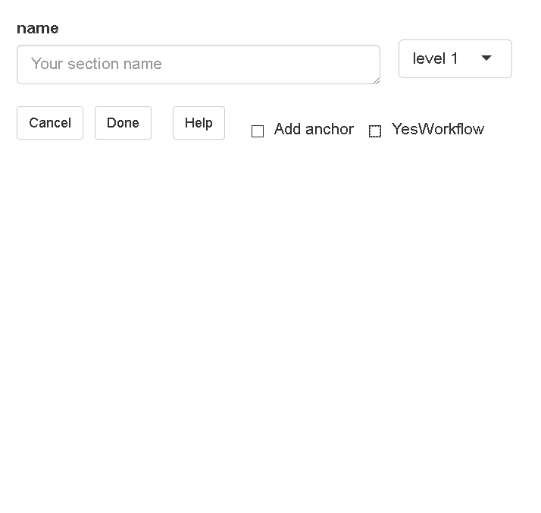
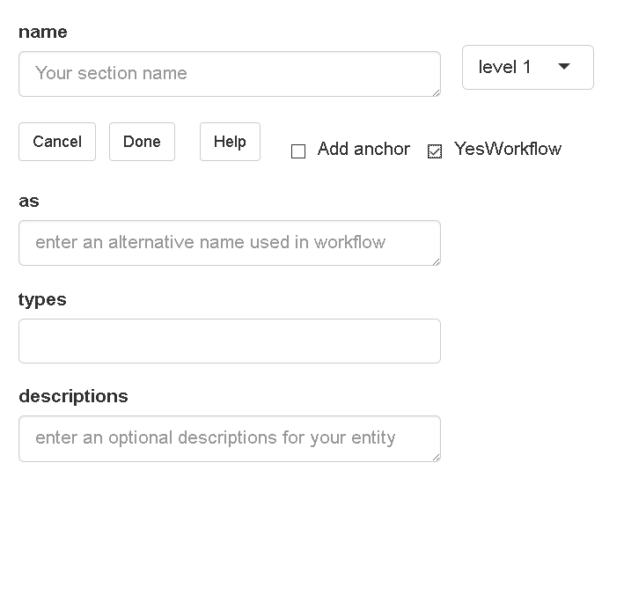
Adding YesWorkflow annotations
Now: Based on a user interface, adding a single line of YesWorkflow to R scripts.

Slide 3
Adding YesWorkflow annotations
The name of each input
For indent: how many blanks will appear at the begining of YesWorkflow annotations.
Alternative name used in YesWorkflow.
Different types of YesWorkflow entities.
An optional description for each entity

Slide 4
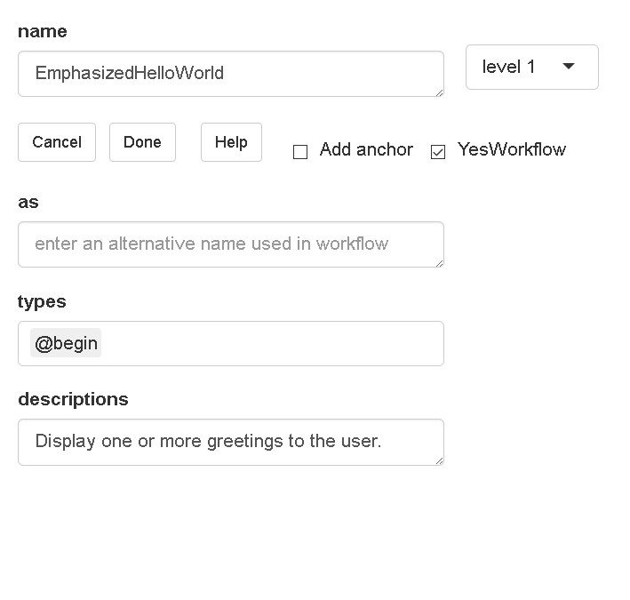
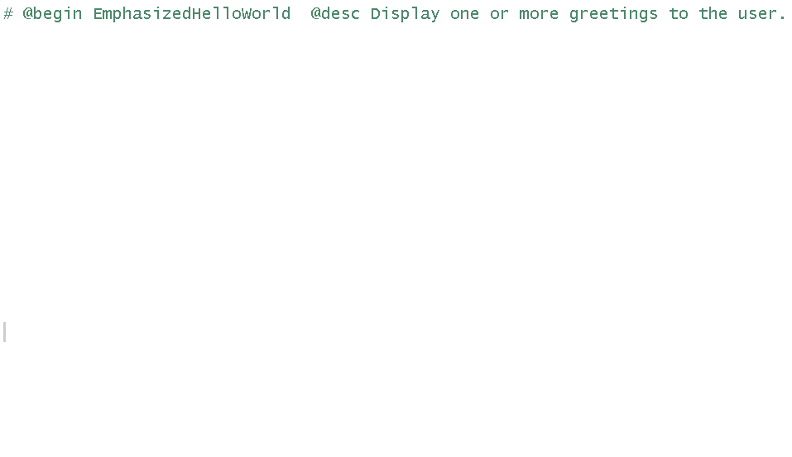
Adding YesWorkflow annotations

Slide 5
Adding YesWorkflow annotations
Limitations:
Not convenient enough. Users must understand them meaning of different types.
Not efficient enough. Users have to type most of things manually and do not save time.
Solutions:
Generate a chunk of several lines of YesWorkflow annotations together.
Show “input data”, “output data”, or “block name” on UI which can be understand by users easily. And generate YesWorkflow annotations based on those informaiton.
Trying to find out a better layout for UI instead of current “text_focus” text bar and “selectizeInput” multiple-input bar.

Slide 6
Adding YesWorkflow annotations
Future work and Suggestion:
Limited by the function of Shiny (UI package in R studio), it is not a real-time based tool which cannot read real-time data and show the result on UI.
Maybe can generate a function which works together with Shiny to summary existing information and show the result on UI, such as what entities have already in the annotations.
Using another new platform may be better for solving this problem since R is not a programing platform which has many limitations on function especially for editing the software itself.
Generate annotations directly from R scripts.
It is a very interesting quesion which can start from creating annotations from a user-defined function follows the structure: function(input1,input2){processing, return(output)}
Then based on different types of function, revised it again and again.
{

Slide 7
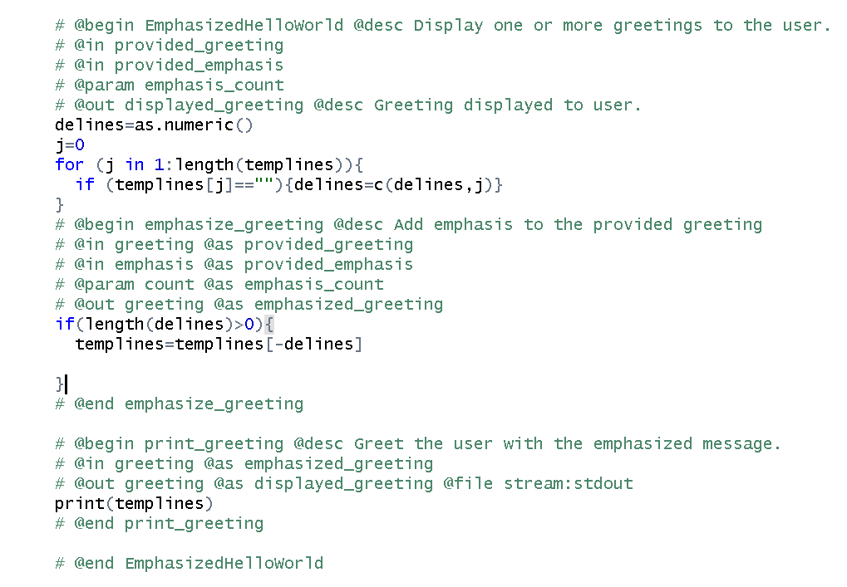
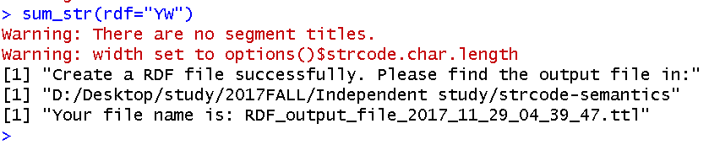
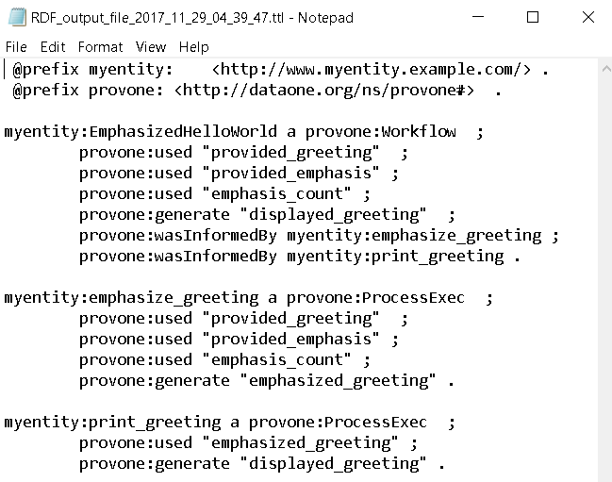
Generating RDF file from YesWorkflow annotations
Suppose we have some YesWorkflow annotations in R scripts as follows:
F

Slide 8
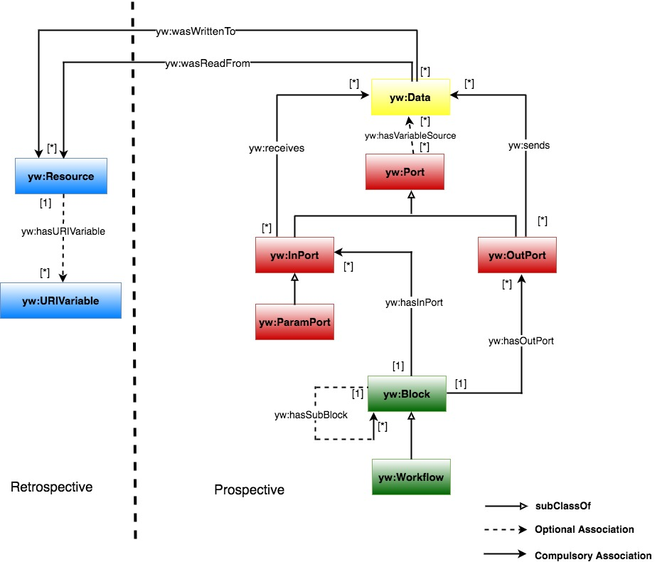
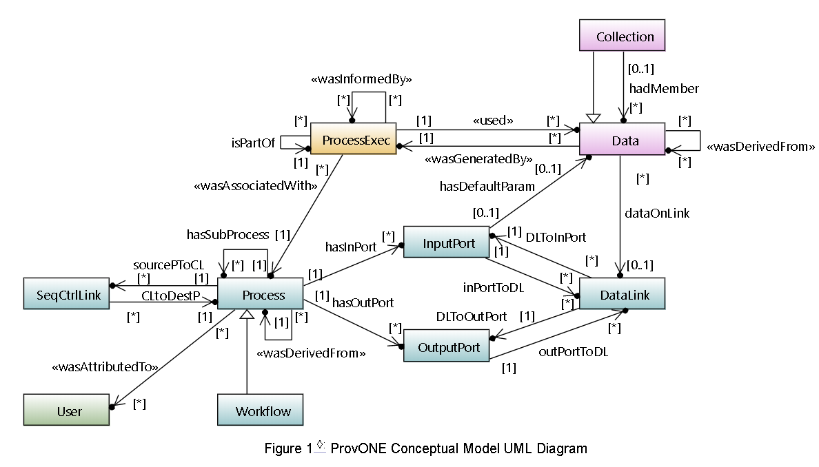
Adding YesWorkflow annotations
Now: We can generate RDF file in turtle format both based on YesWorkflow namespace or ProvONE ontology.

Slide 9
Adding YesWorkflow annotations
For the summary function:
The summary function will get all YesWorkflow annotations together first by using special marks “# @”.
Then, find each pair of @begin and @end annotations in the annotations to find a hierarchy nesting structure of the annotations.
Generating RDF file in turtle format based on ProvONE or YesWorkflow ontology.
Limitations:
It can be used in only one level nesting structure right now.
It only contains essential information:”name, input data, output data, @as name”.
It returns some warning message when running in the R extension, but works well as an independent function. Troubleshooting is needed for removing these warning messages.(It casued by empty level information in summary processing.)

Slide 10
Summary of Independent study
Started from Linh and Hui’s repository to learn some basic concept about YesWorkflow, including Conceptual Model, and query examples.
By testting several YesWorkflow query method, including SPARQL queries and RDF-facts queries to get a better understanding of YesWorkflow.
Tested PaleoCar project, and help developer to finish several troubleshooting work.
Learned from existing Dependency Analyzer Tool of YesWorkflow and planed to add this function to mark-down R extension in the future.
Extended my R extension (actually based on it I created a new tool) that can add YW annotations inside of R scripts in a way similar to my original function..
Added a new function in summary function to get all YesWorkflow annotations and generate RDF file in turtle format with YesWorkflow or ProvONE ontology.
Working notes for independent study Independent Study Report

